Slide 1
Guide to Diagnosing Coronary Artery Disease

Slide 2
Data cleaned and vizualized: Matplotlib,Pandas, Scikit-Learn
Proccessed: Numpy, Scikit-learn, Inbalanced learn.

Slide 3
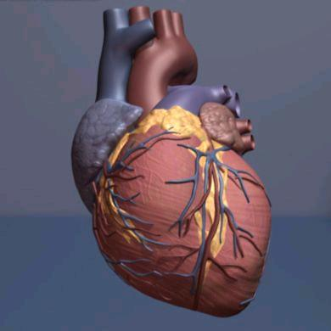
Overview
Coronary artery disease is a common heart condition. The major blood vessels that supply the heart (coronary arteries) struggle to send enough blood, oxygen and nutrients to the heart muscle. Cholesterol deposits (plaques) in the heart arteries and inflammation are usually the cause of coronary artery disease. Signs and symptoms of coronary artery disease occur when the heart doesn't get enough oxygen-rich blood. Coronary artery disease often develops over decades. Symptoms may go unnoticed until a significant blockage causes problems or a heart attack occurs. It is one of the leading causes of death and morbidity worldwide, along with other associated cardiovascular diseases, it accounted for 17.9million deaths worldwide in 2021, or 31% of all global deaths.

Slide 4
Causes
The primary cause of CAD is atherosclerosis, a condition where cholesterol, fat, and other substances accumulate in the arterial walls, forming plaque. Over time, this plaque narrows the arteries, reducing blood flow to the heart. The exact cause of atherosclerosis is multifactorial and can include factors like high cholesterol, high blood pressure, smoking, and genetic predisposition.

Slide 5
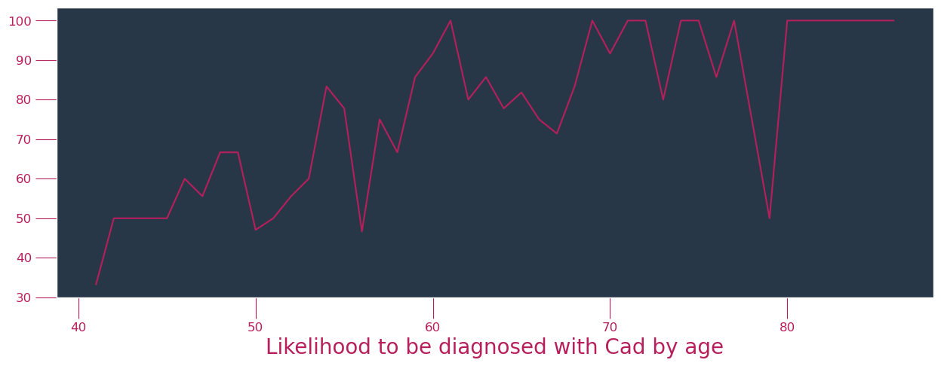
Risk Factors
11.Age: The likelihood of being diagnosed with coronary artery disease (CAD) generally increases with age. CAD is more prevalent in older individuals, and the risk factors for CAD, such as high blood pressure, high cholesterol, and diabetes, tend to become more common as people age. However, it's important to note that CAD can affect individuals of all ages, and lifestyle factors also play a significant role in its development.

Slide 6
2. Diabetes
Diabetes is a chronic medical condition characterized by high levels of sugar in the blood, either because the body doesn’t produce enough insulin(Type1) or because it doesn’t use insulin effectively(Type2). Diabetes,especially Type 2 is a well established risk factor for the development and progression of CAD.
High levels of glucose in the blood can damage the lining of the coronary arteries and lead to atherosclerosis,which is the buildup of fatty deposits in the arteries, this narrows the artery and restricts blood flow to the heart. People with diabetes are likely to develop CAD at an earlier age and have more extensive arterial blockages.
Diabetes can cause small blood vessel disease reducing blood flow to the heart muscle.
CAD is also a major cause of complications and mortality in people with diabetes, individuals with diabetes are at a greater risk of experiencing heart attacks, heart failures e.t.c

Slide 7
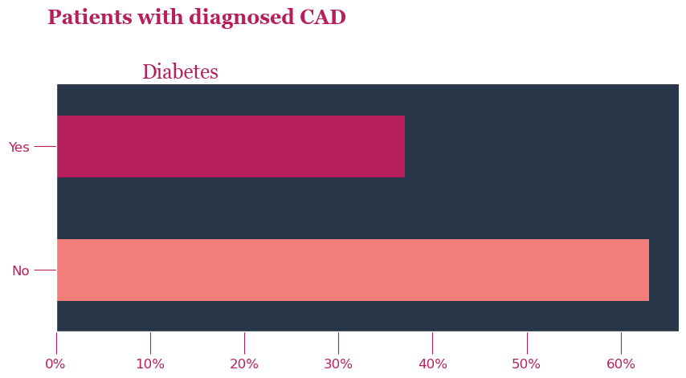
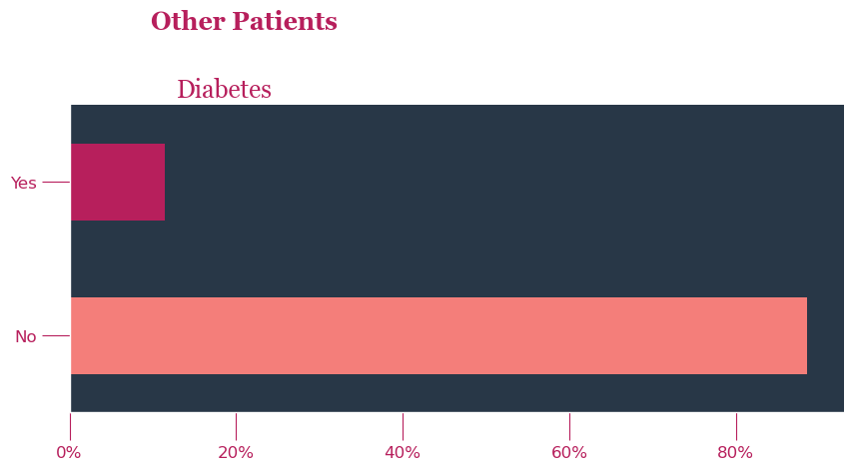

Slide 8
3. Blood Pressure
High blood pressure, or Hypertension is a significant risk factor for CAD, hypertension forces the heart to work harder to pump blood, over time, this can lead to the thickening of the heart muscle(left ventricular hypertrophy) which can reduce the heart’s ability to pump efficiently, and contribute to CAD. This can also damage the inner lining of the arteries, making them more susceptible to the buildup of fatty deposits(atherosclerosis).
This elevated pressure can also lead to the constriction of the coronary arteries that supply blood to the heart, reducing flow of oxygen and nutrients to the heart muscle, increasing the risk of chest pain and heart attacks(chest pains are an important diagnostic symptom for CAD).
Diagnosed hypertension is sustained high pressure above 120mmHg when your heart squeezes and pushes blood out of your body.

Slide 9
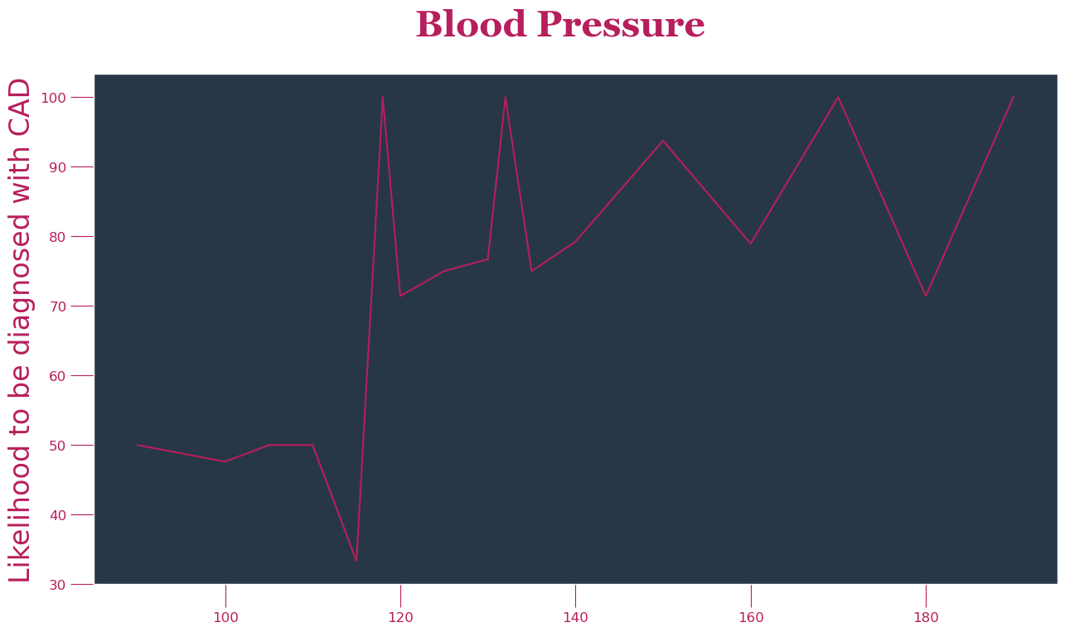

Slide 10
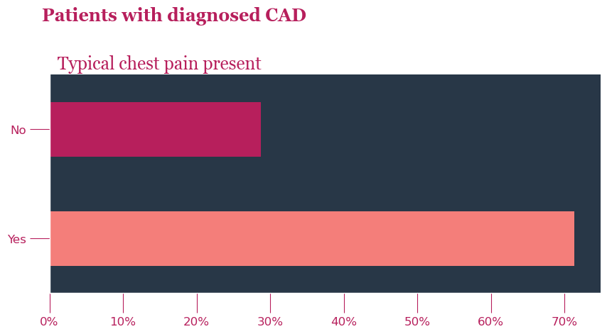
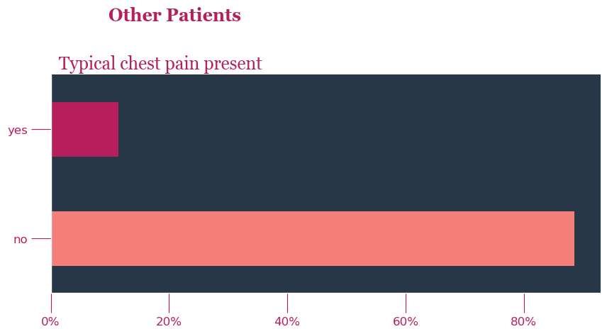
Symptoms and Signs
1.Typical angina: Constricting discomfort in the front of the chest or in the neck, jaw, shoulder, or arm. It happens when your heart isn’t getting enough oxygen and blood temporarily. Often happens when you are active and stressed, and it can be relieved by rest or medication. This is a major symptom of CAD.

Slide 11
Major signs include:
Regional wall motion abnormality: this represents decreased contractility of the wall of the heart due to decreased blood supply to a part of the heart.
Four types:
Akinesis: part of the heart muscle doesn’t move or contract properly, due to lack of blood flow. It affects the heart’s ability to pump blood effectively.
Hypokinesis: decreased movement in the heart muscle,often due to injury or disease.
Dyskinesis: uncoordinated movement or muscle contractions, leading to abnormal motion.
Aneurysmal: part of the heart muscle is bulging or moving differently.

Slide 12
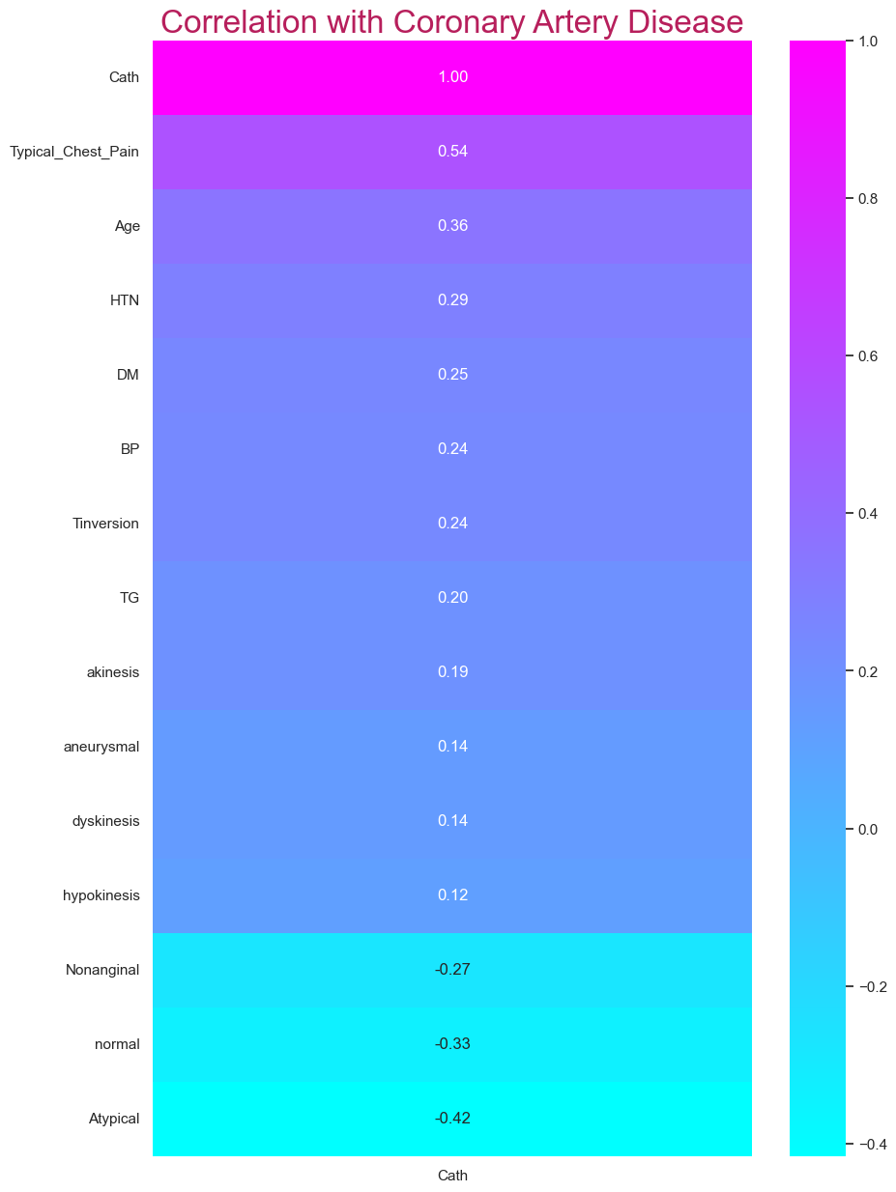

Slide 13
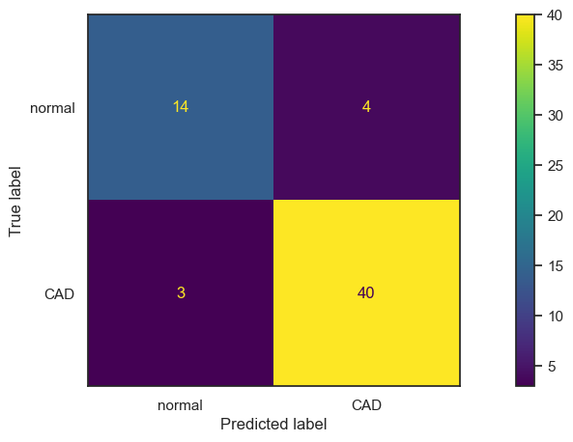
Model performance on 61 randomly tested patients

Slide 14
Preventing Coronary Artery Disease
Preventing coronary artery disease (CAD) involves adopting a heart-healthy lifestyle. Here are the main ways to prevent CAD:
Healthy Diet: Consume a balanced diet low in saturated and trans fats, cholesterol, and sodium. Focus on fruits, vegetables, whole grains, lean proteins, and unsaturated fats (e.g., olive oil).
Regular Exercise
Quit Smoking: Smoking is a major risk factor for CAD. Quitting smoking reduces your risk of heart disease significantly.
Manage Stress: Chronic stress can contribute to CAD. Practice stress-reduction techniques such as meditation, deep breathing, or yoga.
Limit Alcohol:
Control Blood Pressure: Monitor and manage your blood pressure within a healthy range (usually below 120/80 mm Hg).
Manage Cholesterol Levels: Keep your cholesterol levels in check, especially low-density lipoprotein (LDL) cholesterol. Medications may be necessary for some individuals.
Manage Diabetes: If you have diabetes, maintain good control of your blood sugar levels.
Maintain a Healthy Weight Aim for a body mass index (BMI) within a healthy range.
Regular Checkups: Visit your healthcare provider regularly for checkups and screenings. Detecting risk factors early can help prevent CAD.
Medications:
Family History Be aware of your family's history of CAD, as genetics can play a role. Discuss this with your doctor.
Adequate Sleep Aim for 7-9 hours of quality sleep each night. Poor sleep can contribute to heart disease risk.
Avoid Processed Foods: Minimize processed and fast foods, which are often high in unhealthy fats, sugars, and salt.
Hydration: Stay well-hydrated by drinking enough water, which supports overall health.
It's important to tailor your approach to CAD prevention to your specific risk factors and consult with a healthcare professional for personalized guidance.
In [ ]:

